Slide 1

EXPORT ACADEMY
Part 2

Slide 2
Housekeeping​
1) Please keep your cameras off and microphones muted 2) Please use chat function to ask questions we will try and answer all questions where possible. Any unanswered queries will be collated and responded to after the webinar.​ 3) The sessions will be recorded today and emailed to all attendees We would like to encourage participation from all delegates. ​ ​ Export Academy Programme Co-ordinator – helen.shaw@tradene.org​

Slide 3

EXPORT SKILLS
WORKSHOP
Module 6 – Export Controls
Presented by Jade Forshaw, Trade, Compliance Consultant ​
Connect with Jade on LinkedIn - https://www.linkedin.com/in/jade-forshaw-0a843258/
Notes:
More layout available for each regions

Slide 4

AGENDA
Export Controls
6
Prohibitions and restrictions
6
Military & Dual-use Lists
6
Export Licences & SPIRE
6
Embargoes & Sanctions
4

Slide 5
What are export controls?
The control of goods, software and technology is necessary due to:​
The collective security of the UK and its NATO allies​
National security​
Foreign-policy requirements​
International-treaty obligations and commitments​
Non-proliferation policy​
Concerns about terrorism, internal repression and other human-rights violations
Notes:
5

Slide 6



Why have export controls?
Remember – there are
catch-all controls:
Weapons of Mass
Destruction (WMD)
Embargoes and
Sanctions
Goods, software and technology fall under one of the following:
Not controlled
No license required (NLR/LIC99)
Controlled
Dual-use (EU regulations)
Controlled Military
(UK national controls)
End-use concerns
All goods – catch-all controls
In addition we need to be aware of USA
re-export controls

Slide 7


Export Control Regulations?
Export controls are made up of several regulations:​
The Export Control Order 2008​
  UK Military List (Schedule 2)​
  UK Security & Human Rights List (Articles 4A & 9)​
  UK Dual-Use Control List (Schedule 3)​
Annexes II & III of Council Regulation (EC) No. 1236/2005​
  EU Human Rights List​
The Export of Radioactive Sources (Control) Order 2006​
  UK Radioactive Sources List​
Annexes I & IV of Council Regulation (EC) No. 428/2009​
  EU Dual-Use List
Notes:
UKTI – changed the name to DIT in 2016 (and expanded to include UKEF as well as Trade Policy Group from BIS) as we have mentioned throughout the day.
MOD - Reference Point for the Form F680 which may be needed to support a Licence Application for goods that are classed Official Sensitive and Above.
The ECJU brings together operational and policy expertise from the Department for International Trade’s Export Control Organisation (ECO), the Foreign & Commonwealth Office (FCO) and Ministry of Defence (MOD) to promote global security through strategic export controls and facilitate responsible exports

Slide 8

Rules and regulations
Various government bodies involved…
HMRC | Policy - Prohibitions & Restrictions (P&R)
APHA | Animals, plants and their products
Defra | Conservation controls - CITES
Defra | CFCs and ozone depleting substances
HMI | Fruit and vegetable standards
Home Office | Controlled drugs and precursors
DIT | Military exports
DIT | Dual-use exports
DCMS | Cultural goods
Notes:
HMRC Her Majesty’s Revenue & Customs
UKBA UK Border Agency (aka. Border Force)
DIT Department for International Trade (was the DTI, then BERR then BIS)
Defra Department for the Environment and Rural Affairs
APHA Animal and Plant Health Authority
Forestry Forestry Commission
DCMS Department for Culture Media and Sport
Home Office

Slide 9
Who you need to know?
Important government departments
  Department for International Trade (DIT)
  Formerly UK Trade & Investment (UKTI), which was part of the Department for Business, Innovation and Skills (BIS) and Foreign & Commonwealth Office (FCO). Changes made in July 2016. The Export Control Joint Unit (ECJU) brings together the ECO, FCDO (formerly the FCO) and MoD.
  ECJU has overall responsibility for export licensing policy (but HMRC and Border Force police it!)
  ECJU routinely requires end-use information in connection with export licence applications
  Assesses whether the export is capable of being used for manufacture of Weapons of Mass Destruction (WMD)
  Ministry of Defence (MoD)
  Responsible for providing military, technical and equipment security advice on export-licence applications
  Advises if risk of any export being used against British forces and accesses risk of diversion to third-country destinations or terrorists
  Considers former activities of the end-user and their government and views the possibility of
  de-stablising a political situation
Notes:
UKTI – changed the name to DIT in 2016 (and expanded to include UKEF as well as Trade Policy Group from BIS) as we have mentioned throughout the day.
MOD - Reference Point for the Form F680 which may be needed to support a Licence Application for goods that are classed Official Sensitive and Above.
The ECJU brings together operational and policy expertise from the Department for International Trade’s Export Control Organisation (ECO), the Foreign & Commonwealth Office (FCO) and Ministry of Defence (MOD) to promote global security through strategic export controls and facilitate responsible exports

Slide 10
Who you need to know?
Important government departments
  Foreign, Commonwealth & & Development Office (FCDO)
  Sole responsibility for considering the foreign-policy implications and human-rights issues of any proposed export or controlled goods
  Consider the UK’s responsibility to other organisations, e.g. MTCR, Australia Group
  Adhere to international arms/trade embargoes
  Technical and economic capabilities of the recipient country
  UK Defence and Security Exports (UKDSE)
  Main role is to promote the sale of military products overseas
  Under the Form 680 procedure, manufacturers of military products apply for permission to promote the sale
  of goods, or the release of information related to their products to overseas markets
  Form 680 is to “help direct marketing efforts”
  Apply for Form 680 via the SPIRE website
Notes:
And some background on the FCDO and UKDSE
FCDO
The FCDO pursues the UK’s national interests and projects the nation as a force for good in the world. It promotes the interests of UK citizens, safeguards the UK’s security, defends its values, reduces poverty and tackles global challenges with its international partners. FCDO is a ministerial department, supported by 12 agencies and public bodies.
DIT’s UK Defence and Security Exports (UKDSE, formerly UKTI DSO) team has around 105 staff in London and another 27 members in our export support team. UKDSE has around 20 diplomatic posts overseas with the title ‘First Secretary, Defence and Security’.

Slide 11
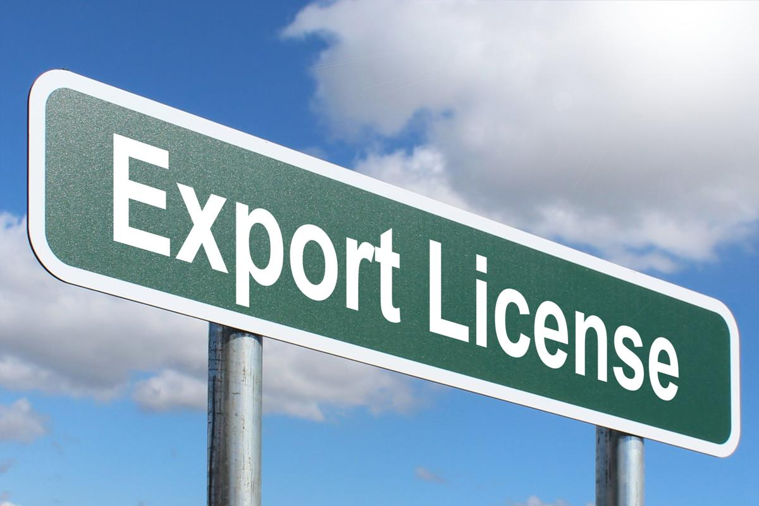
Do we need an export licence?
Most technology/goods leaving UK don’t need export-control approval
Controlled goods/technology divided into
  Dual-use
  Military
  Catch-all (WMD related)
You need to understand if your products/technology are controlled
Exceptions to the export licensing regulations are listed in Volume 1 HMRC Tariff,
e.g. export by government departments
UK Export Licence controls affect the export of​
  any controlled material (including technology)​
  for any reason (including temporary shipments)​
  by any method (including hand-carried and intangible transfer, e.g. email)​
  Irrespective of ownership
This Photo by Unknown Author is licensed under CC BY-SA
Notes:
11

Slide 12
Prohibitions and restrictions
Full list in Volume 1 of the UK Trade Tariff​
https://www.gov.uk/government/publications/uk-trade-tariff-export-prohibitions-and-restrictions/uk-trade-tariff-export-prohibitions-and-restrictions
Volume 1 of the Tariff
Some goods are controlled as prohibitions or restrictions (P&R goods)
National restrictions – health, security
  Other legislation – counterfeit goods, animals, furs, etc​
  Agricultural goods – CAP: Defra: RPA​
  Department for Digital, Culture, Media and Sport
  Restricted goods may be identified against their commodity-code number
Licensing is used:
  to protect UK/EU industries
  to stabilise markets and promote free trade
  for surveillance in respect of sensitive goods
  for public health and safety
  to prevent the proliferation of military and dual-use goods
Notes:
12

Slide 13
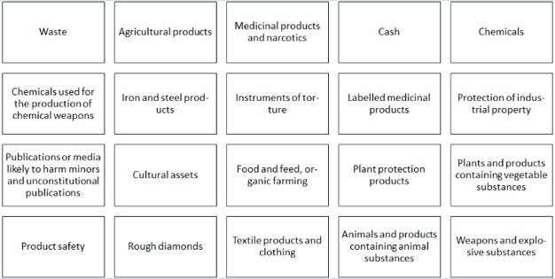
Prohibitions
Notes:
13

Slide 14

Military & Dual-use Items

Slide 15
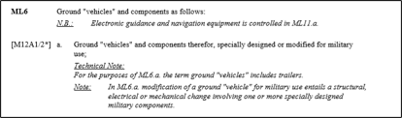
Military Goods Software and Technology
Goods and technology relating to goods specially designed or modified for military use
Technology is information that is capable of being used in connection with the...
  Design of controlled goods
  Development of controlled goods
  Production or use of controlled goods
Australia, Austria, Belgium, Canada, Denmark, Finland, France, Germany, Iceland, Ireland, Italy, Japan, Netherlands, New Zealand, Norway, Spain, Sweden, United Kingdom, USA
This special design for military purposes could have happened at any time in the past
Notes:
I think – although the information can be sometimes difficult to establish – it should be reasonably straight forward to establish that……
Goods specially designed or modified for Military Use.
Is the item off the shelf?
It’s OK – but can you make one or two changes to it?
In the UK we work to the Military List – other countries have their own equivalents.
Currently Exporters have to Self Rate their goods. Previously there was the facility to obtain assistance in the rating of goods from the export control organisation – but that is no longer in place.
There is talk of a rating service returning.

Slide 16
Military list classification list
ML1 – Arms and automatic weapons
ML3 – Ammunition
ML5 – Fire control equipment
ML7 – Chemical or biological
ML9 – Vessels
ML11 – Electronic equipment
ML13 – Armoured or protective eqpt
ML15 – Imaging/counter-measure eqpt
ML19 – Directed weapon energy systems
ML21 – Software
ML2 – Armaments (greater calibre)
ML4 – Bombs, torpedoes, etc
ML6 – Ground vehicles
ML8 – Explosives and propellants
ML10 – Aircraft
ML12 – Kinetic energy weapons
ML14 – Training/simulations eqpt
ML16 – Forgings/castings
ML20 – Cryogenic/super conductive
ML22 – Technology
This list doesn’t provide the complete classification information!
Notes:
These are the 22 categories of the Military List.
These are broken down further with a letter and a number to establish the full classification.
As the previously slide alluded to – if the goods are controlled – then the software or technology that relates to the goods will also be controlled.
The rating purposes you will need the ML rating that the goods or software relates to.
The section of the UK Strategic Export Controls List that relates to Military Goods is a relatively slim volume.
The design question can sometimes present a problem to exporters if the original design is going back a number of years.
My advice would be to err on the side of caution – if in doubt apply for a licence.

Slide 17
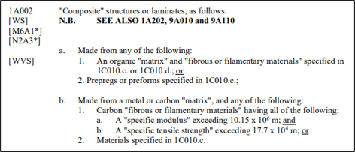
Dual-use Goods, Software & Technology
Goods of a commercial design but are of a specification that makes the item capable of being used in military type scenarios. ​
Items are only dual use if listed in the dual use list. ​
Dual-use goods are based on their technological capabilities – categories in sections in-line with the Wassenaar Agreement
Notes:
17

Slide 18
UK Dual Use List
Categories​
Category 0: Nuclear Materials​
Category 1: Materials, chemicals, ​
micro-organisms and toxins​
Category 2: Materials Processing​
Category 3: Electronics​
Category 4: Computers​
Category 5: Telecommunications and ​
Information Security​
Category 6: Sensors and Lasers​
Category 7: Navigation and Avionics​
Category 8: Marine ​
Category 9: Aerospace and Propulsion ​
Sub-Categories​
A: systems, equipment & components​
B: test, inspection & production ​
equipment​
C: materials ​
D: software ​
E: technology
Notes:
18

Slide 19
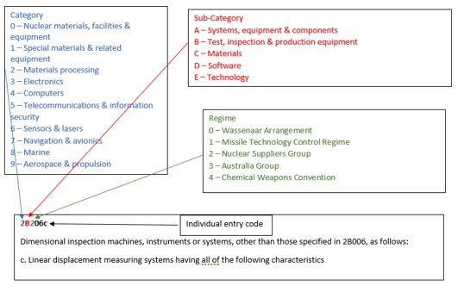
Export Control Number (ECN)
A technical expert or engineer should be involved with classifying products and allocating the ECN
Notes:
19

Slide 20
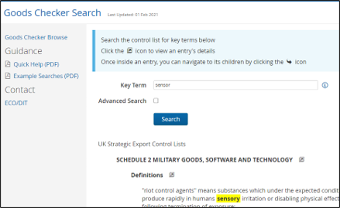
Goods checker
The goods checker helps to establish if your items are controlled and identify the appropriate control
entry ('rating') from the UK Strategic Export Control Lists. If so, you will need to apply for an appropriate export licence.
Link:https://www.ecochecker.trade.gov.uk/spirefox5live/fox/spire/OGEL_GOODS_CHECKER_LANDING_PAGE/new
Notes:
Discussion re OGEL checker and Goods checker.
I think the OGEL checker is very useful.
You need to know the rating of the goods – the country of delivery – the consignee plus the country of end use – and the rating.
With this information the OGEL Checker will provide you with details on the potential licences that you may consider using – based on the information that you have provided.
You are provided with a direct link to the licences which will allow you to review them in more detail.
Goods Checker – Is really the same as searching through the Strategic Control lists to find matches. It can be useful as it lists all the areas that provide a match in one go.
Only as good as the word you enter!!

Slide 21
EXPORT LICENSING & SPIRE SYSTEM
Module 6 – Export Controls

Slide 22
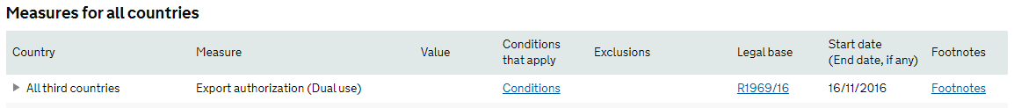
Export license – Post Brexit
Military goods and technology - no change
Drugs have need to be registered today but additional licenses will be needed for some products
DUAL USE goods, software & technology – Items will now require a license when shipped into the EUKey term: dual-use controlled goods
The commodity code in the UK Trade Tariff may “indicate” whether export controls may be required but does not determine the classification
2
2

Slide 23
Export licences – Post Brexit
New licences will apply after the end of the implementation period ​
OGEL - export of dual-use items to EU member states https://www.gov.uk/government/publications/open-general-export-licence-export-of-dual-use-items-to-eu-member-states​
GEA 001, 002, 003, 004 & 005 – Replace the EUGEA OGELs​
  For shipments of dual use goods into the following countries:​
  Australia, Canada, Japan, Liechtenstein, New Zealand, Noway, Switzerland, USA​
EU GEA 001, 002, 003, 004 & 005 – For use only when shipping form Northern Ireland​
  For shipments of dual use goods into the following countries:​
    Australia, Canada, Japan, Liechtenstein, New Zealand, Noway, Switzerland, USA
Notes:
23

Slide 24
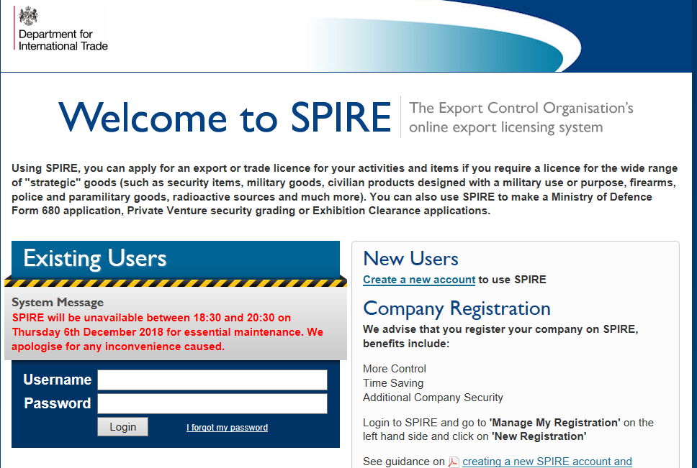
SPIRE is… Shared Primary Information Resource Environment
CHIEF = Customs Handling of Import
Export Freight (UK Customs
computer)
BEIS = Department for Business,
Energy and Industrial
Strategy
BF = Border Force
GCHQ = Government
Communications
Headquarters
FCDO = Foreign, Commonwealth
& Development Office
  Interacts with HMRC CHIEF system to validate and decrement licenses
  Electronic export licensing system since 2007 –
  http://www.spire.gov.uk
  Interacts with government departments: Border Force, DIT-ECJU, FCDO, MoD, BEIS, GCHQ, HMRC, etc.
  ECJU currently working on a replacement to SPIRE called LITE
Notes:
A slide on SPIRE……
Change the SPIRE link……. On this page.
Link to CHIEF the HMRC Computer
A SIEL needs to be decremented.
Link to Other Governments Departments – as seen on the SPIRE application. “OGD”
LITE WILL BE THE UPDATED VERSION OF LITE – YOU CAN SIGN UP TO A BLOG.

Slide 25
Registering on SPIRE
Home page registration, sent a password
Access main site, can either:
  Use it without full registration but Should register company details
  EORI (formerly the VAT No.)
  SPIRE provides access to…
  Export-licence applications
  OGEL registrations
  Goods checker/OGEL checker
  Classification search facility
  End-user advice service
  Classification guidance
  Company and license maintenance
  View applications/licenses
  OGEL returns
Notes:
Just a quick note to talk about SPIRE.
The SPIRE system works on the basis of one SPIRE registration per Companies House registration number
Create a registration for your company
In the current guise of SPIRE there is a 2 part application process.
Once you have submitted the registration via SPIRE, ECJU (ECO) will then send a letter (posted in hard copy) to the Authorised Company Executive (e.g., Company Secretary), as nominated in the Companies House registration, at the Companies House Registered address.
- This letter will ask the company secretary to sign a declaration stating that the user that has set up the account is authorised to do so by the company, that they are further authorised to nominate additional users within the registration and at the required access levels.
We’ve experience this being lost in the past – so be careful!
DISCUSS – OTHER THINGS THAT SPIRE CAN DO.

Slide 26
Individual licence applications
  Apply online through SPIRE
  Workbasket – new application
  Select type, e.g. SIEL and whether permanent or temporary export
  Your reference number
  Organisation applying
  Description and part number
  Relevant export control entry
  Quantity and value.
  Note: Value must be in GBP
  Nature of goods
    Military use, cryptographic, nuclear
    use, firearms
    Protective marking, e.g.,
    official-sensitive, secret
    Whether to be incorporated as part
    of some other equipment/system
  Organisation and country of destination
  Attached documents
Notes:
Licence applications are raised through SPIRE – SPIRE to be updated and revised in the not too distant future. The update version will be called LITE.
There is a blog you can sign up to which allows you to track the progress of the updated version. Updates have also been posted via Notice to Exporters.
You need a SPIRE account – set up as an Organisation to apply for licences. Each user needs their own log on details. Administrator sets up the individuals rights.
Apply for licences / view applications / read applications etc etc.
Interesting about the Export Control Entry…… (Doesn’t need to be included)
Value in GBP – RoE from the HMRC website.

Slide 27
Main types of licence applications made via SPIRE
OGEL | Exporters must register before first use. Need to adhere to terms and conditions. Reporting requirements. Use of the licence will be audited by the ECJU
SIEL | Application for a single consignee/end user – Multiple Shipments – Two years validity for specific quantities. Licence must be decremented
OIEL | Covers multiple shipments to a number of countries with an unlimited quantity and value. Longer application process than a SIEL
UGEA | EU wide general authorisations covering certain shipments of dual-use products to certain destinations. (UGEA for UK post–Brexit?)
WARNING!!!​
CHECK CONDITIONS ​
KEEP RECORDS & SUPPORTING DOCS
Notes:
27
Copyright S&H 2008
27
CAN REALLY EXPAND ON THIS
OGEL – OPEN AUTHORISATION – SELF POLICING UNTIL YOU ARE AUDITED – CAN YOU ADHERE TO THE TERMS AND CONDITIONS?
END USE / REASON / RATING / SUPPORTING DOCUMENTATION.
UGEA – LIKE AN OGEL – BUT EU WIDE SPECIFIC AUTHORISATIONS FOR A SPECIFIC REASON AND COUNTRIES
SIEL – THERE IS NO OGEL OR YOU MAY CHOOSE TO NOT REGISTER FOR AN OGEL – REGISTRATION VERSUS APPLICATION – SPECIFIC TO YOUR NEEDS = SUPPORTING DOCUMENTATION – LONGER LEADTIME
PROJECT LICENCES – RARELY USED AND THAT WILL DIMINISH / DISAPPEAR WITH BREXIT

Slide 28
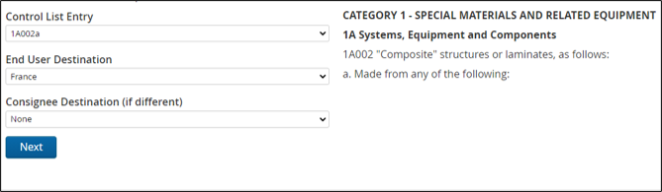
OGEL Checker
The OGEL checker helps to identify if an appropriate Open General Export Licence (OGEL) exists. If so, ensure you can meet all the terms and conditions, before registering via SPIRE.
If either no OGELs exist or you cannot meet all conditions, you will need to apply for a Standard Individual Export Licence (SIEL) via SPIRE.
Note: Registered OGEL users are subject to ECJU compliance audits.​
LINK: https://www.ecochecker.trade.gov.uk/spirefox5live/fox/spire/OGEL_GOODS_CHECKER_LANDING_PAGE/new
Notes:
28
Copyright S&H 2008
28
Trying to make the world as safe as possible.
Who is the customer – who is the ultimate customer – what will they be using the goods or technology for?
Proliferation – Unintentional spreading – need to control the movement of the goods.
Non-Proliferation policy needed.
Need to carry out due diligence
You need to happy that when goods are exported they are satisfied that the end use has been clarified and they can support this information with documentary evidence.
AS WELL AS MILITARY GOODS I ALSO NEED TO MENTION DUAL USE GOODS AND THE REQUIREMENTS FOR A LICENCE OUTSIDE THE EU – DUAL USE GOODS CAN MOVE FREELY IN THE EU FOR END USE IN THE EU
WITH A LICENCE BUT KNOWLEDGE IS EVERYTHING END USE NEEDS TO BE ESTABLISHED AND THAT’S WHAT THE LICENCE REQUIREMNENT NEEDS TO BE BASED UPON.
EXPORTER OF RECORD = RATING = LICENCE RESPONSIBILITY

Slide 29
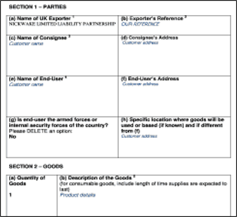
Supporting documents
End User Undertaking (SIEL’s)
SIEL applications:​
Official end user undertaking ​
  Original wet ink copy must be kept on record ​
  Must be on company letter head ​
Technical specifications, brochures and/or data sheets​
OGELs:​
Some require supporting documentation, often a Consignee undertaking​
It depends on the Terms and Conditions of the licence​
You can upload supporting documents to the SPIRE application
Notes:
Supporting documentation is required for SIELs and OIELs
Without this information the application won’t get past first base.
There is an option in the SPIRE application section where you can omit these documents but it would seem strange to do so. They could be posted – but in this era – it doesn’t seem likely.
The supporting documents are “attached” to the application as a pdf.
The EUU is in a specific format which you can find online. You can have a copy in your possession for the licence application – but you need to obtain and retain the original on your file.
Technical Specifications – relating specifically to the products that need a licence for.
Many items – combine into one Tech Spec in the order of the application and EUU – quoting the relevant licence number.

Slide 30
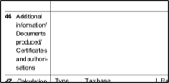
Conditions & Checks
You must ensure the Commercial invoice contains:​
Export control number for each item ​
Export licence number ​
Destination control statement ​
The above items are controlled under ECN??? And are to be shipped using export licence number ?????/??????​
If re-exported these items may require an export licence
You must ensure the C88 doc has the correct code and licence number:​
You declare X002 (dual-use) or 9103 (military) in Box 44 of your export declaration.​
You comply with all requirements of the licence, including those answered in the OGEL checker.
Notes:
Supporting documentation is required for SIELs and OIELs
Without this information the application won’t get past first base.
There is an option in the SPIRE application section where you can omit these documents but it would seem strange to do so. They could be posted – but in this era – it doesn’t seem likely.
The supporting documents are “attached” to the application as a pdf.
The EUU is in a specific format which you can find online. You can have a copy in your possession for the licence application – but you need to obtain and retain the original on your file.
Technical Specifications – relating specifically to the products that need a licence for.
Many items – combine into one Tech Spec in the order of the application and EUU – quoting the relevant licence number.

Slide 31
EMBARGOES AND SANCTIONS
Module 6 – Export Controls

Slide 32
Embargoes and sanctions
Targeted restrictions to maintain and restore international peace and security
  Implemented by UN
  Implemented by EU (CFSP)
  Implemented by OSCE
UK follows international procedure to implement. (FCDO Responsible)
US embargoes and sanctions
A constantly changing picture…..
LINK: https://www.gov.uk/guidance/current-arms-embargoes-and-other-restrictions
Notes:
EU – Common Foreign and Security Policy Objectives (CFSP)
Organization for Security and Co-operation in Europe (OSCE) Formed 3/7/73 – Helsinki , Finland.
The OSCE has a comprehensive approach to security that encompasses politico-military, economic and environmental, and human aspects. It therefore addresses a wide range of security-related concerns, including arms control, confidence- and security-building measures, human rights, national minorities, democratization, policing strategies, counter-terrorism and economic and environmental activities. All 57 participating States enjoy equal status, and decisions are taken by consensus on a politically, but not legally binding basis
Where sanctions and embargo measures require more than administrative action to implement them, the UK introduces new or amends existing secondary licensing and enforcement legislation.
US Embargoes on Russia – OFAC Office of Foreign Assets Control
EU Sanctions – Extended till March 2018
Further US Sanctions are pending.
Embargo and Sanctions – ARE TRADE TOOLS TO MAINTAIN OR RESTORE INTERNATIONAL PEACE AND SECURITY!!
BEAR IN MIND THE GOODS TECHNOLOGY AND SOFTWARE CAN BE CONTROLLED
RUSSIA - EMBARGO – SUPPLY OF DUAL USE GOODS FOR A MILITARY END USE OR FOR A MILITARY END USER
OIL AND GAS INDUSTRY CAN BE AFFECTED
ENERGY RELATED EQUIPMENT CAN BE AFFECTED
REPUBLIC OF CRIMEA AND CITY OF SEVASTOPOL (UKRAINE) WERE ILLEGALLY ANNEXED BY THE RUSSIAN FEDERATION
CHANGING PICTURE – WHAT IS HAPPENING IN THE WORLD DIRECTLY AFFECTS HOW SANCTIONS AND EMBARGOES ARE IMPLEMENTED
VENEZUELA
ARMS EMBARGO
PROHIBITION ON THE SUPPLY OF EQUIPMENT WHICH MIGHT BE USED FOR INTERNAL REPRESSION
EQUIPMENT FOR MONITORING COMMUNICATIONS AND FINANCIAL SANCTIONS

Slide 33

Embargoes and sanctions
Embargoes
  Arms and related goods
  Country specific (Russia oil and gas)
  Internal repression
  Military end use
Sanction
  Financial (UK – OFSI, USA – OFAC)
  Trade control restrictions
  On specific countries
Image by https://megapixel.click - betexion - photos for free from Pixabay
Notes:
EU – Common Foreign and Security Policy Objectives
The OSCE has a comprehensive approach to security that encompasses politico-military, economic and environmental, and human aspects. It therefore addresses a wide range of security-related concerns, including arms control, confidence- and security-building measures, human rights, national minorities, democratization, policing strategies, counter-terrorism and economic and environmental activities. All 57 participating States enjoy equal status, and decisions are taken by consensus on a politically, but not legally binding basis
It is vital that individual exporters check that their goods can be exported or traded to a particular destination, as missing or incorrect licences can lead to delays, seizures, fines, penalties or even imprisonment.
Certain specific sanctions are imposed on dual-use goods such as petrochemicals or telecommunications items.

Slide 34
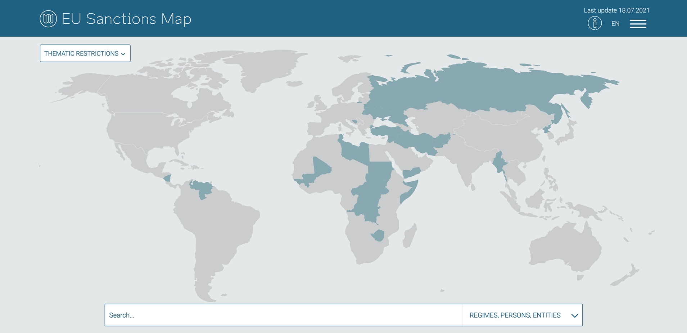
Embargoes and sanctions
Free online EU sanctions map
https://www.sanctionsmap.eu/#/main

Slide 35
UK sanction regimes – Post Brexit
UN sanctions will continue to be implemented in the UK through EU law.​
UK sanctions regimes will come into force under the Sanctions and Anti-Money Laundering Act 2018 (the Sanctions Act)
  https://www.gov.uk/government/publications/sanctions-policy-after-31-december-2020

Slide 36

Financial sanctions
Restrictions that are put in place by the UK, EU or UN for the reasons of foreign-policy implementation or a national security objective.
Restrictions can apply to
  Named individuals, entities and bodies
  Specified groups
  Entire sectors
Licences that allow activity prohibited by financial sanctions are required for a transaction that involves an entity subject to financial sanctions. ​
  Directly or indirectly!​
  It cannot be assumed a licence will be granted​
  Apply at least 4 weeks before it’s required​
  https://www.gov.uk/guidance/licences-that-allow-activity-prohibited-by-financial-sanctions
Notes:
Who is subject to Financial Sanctions?
Email Alerts
General Guidance
Guidance Monetary Penalties for breaches of Financial Sanctions
Financial Sanctions in the UK
Financial sanctions measures can vary from the comprehensive – prohibiting the transfer of funds to a sanctioned country and freezing the assets of a government, the corporate entities and residents of the target country – to targeted asset freezes on individuals/entities.
Financial sanctions may apply to individuals, entities and governments, who may be resident in the UK or abroad. Certain financial sanctions may also prohibit providing or performing other financial services, such as insurance, to designated individuals or governments.
It is a criminal offence to breach a financial sanction, without an appropriate licence or authorisation from the Office of Financial Sanctions Implementation.
HM Treasury, through the Office of Financial Sanctions Implementation is responsible for:
the implementation and administration of international financial sanctions in effect in the UK
licensing exemptions to financial sanctions
domestic designations under the Terrorist Asset-Freezing etc. Act 2010
directions given under Schedule 7 to the Counter-Terrorism Act 2008

Slide 37
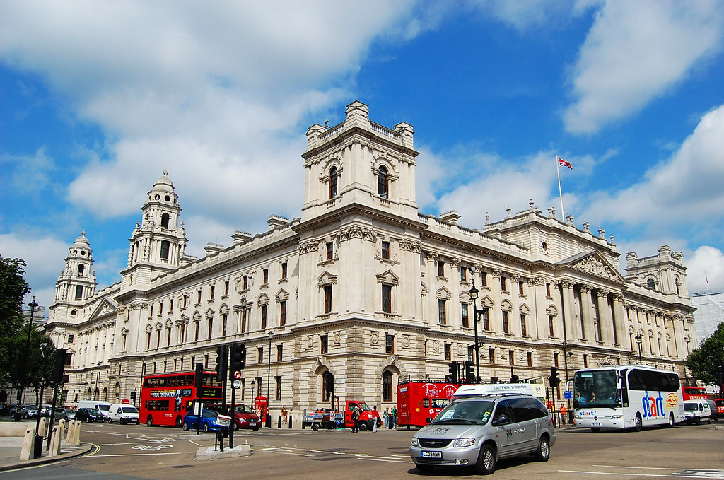
UK OFSI
Office of Financial Sanctions Implementation (OFSI)
Part of the UK Treasury
  Promote and Enable Compliance
  Respond to Non-Compliance
  Change behaviour to Non-Compliance
“(OFSI) helps to ensure that financial sanctions are properly understood, implemented and enforced in the United Kingdom.”
https://www.gov.uk/government/organisations/office-of-financial-sanctions-implementation
The Office of Financial Sanctions Implementation (OFSI) publishes a list of all those subject to financial sanctions imposed by the UK which it keeps updated.
Details are categorised and available in specific regime lists.
This Photo by Unknown Author is licensed under CC BY-NC-ND
Notes:
Who is subject to Financial Sanctions?
Email Alerts
General Guidance
Guidance Monetary Penalties for breaches of Financial Sanctions
Financial Sanctions in the UK
Financial sanctions measures can vary from the comprehensive – prohibiting the transfer of funds to a sanctioned country and freezing the assets of a government, the corporate entities and residents of the target country – to targeted asset freezes on individuals/entities.
Financial sanctions may apply to individuals, entities and governments, who may be resident in the UK or abroad. Certain financial sanctions may also prohibit providing or performing other financial services, such as insurance, to designated individuals or governments.
It is a criminal offence to breach a financial sanction, without an appropriate licence or authorisation from the Office of Financial Sanctions Implementation.
HM Treasury, through the Office of Financial Sanctions Implementation is responsible for:
the implementation and administration of international financial sanctions in effect in the UK
licensing exemptions to financial sanctions
domestic designations under the Terrorist Asset-Freezing etc. Act 2010
directions given under Schedule 7 to the Counter-Terrorism Act 2008

Slide 38

UK OFSI
Office of Financial Sanctions Implementation
Monetary Penalties for the Breach of Financial Sanctions
  Implementation and administration
  Licensing Exemptions to Financial Sanctions
  Domestic Designations (under Terrorist Asset
  Freezing Act 2010)
  Directions given under Schedule 7 to the
  Counter-Terrorism Act 2008
Criminal Offence to breach financial sanctions
https://www.gov.uk/government/collections/enforcement-of-
financial-sanctions
Notes:
Who is subject to Financial Sanctions?
General Guidance
Guidance Monetary Penalties for breaches of Financial Sanctions
Financial Sanctions in the UK
Financial sanctions measures can vary from the comprehensive – prohibiting the transfer of funds to a sanctioned country and freezing the assets of a government, the corporate entities and residents of the target country – to targeted asset freezes on individuals/entities.
Financial sanctions may apply to individuals, entities and governments, who may be resident in the UK or abroad. Certain financial sanctions may also prohibit providing or performing other financial services, such as insurance, to designated individuals or governments.
It is a criminal offence to breach a financial sanction, without an appropriate licence or authorisation from the Office of Financial Sanctions Implementation.
HM Treasury, through the Office of Financial Sanctions Implementation is responsible for:
the implementation and administration of international financial sanctions in effect in the UK
licensing exemptions to financial sanctions
domestic designations under the Terrorist Asset-Freezing etc. Act 2010
directions given under Schedule 7 to the Counter-Terrorism Act 2008

Slide 39

Denied Party Screening
Around the world countries impose sanctions and embargoes to ensure that they do not deal with Countries, companies or individuals on a denied party list ​
All persons and companies are legally obliged to adhere to the relevant sanctions and embargoes. Although Denied party screening is not legally required, it is one of the only ways you can ensure you are adhering to the laws. ​
Using a software system to do the screening is the best way to screen suppliers, customers and affiliates.
Notes:
39
THERE ARE EXPORT PROHIBITIONS IN PLACE
HOME OFFICE – DRUGS EXPLOSIVES CERTAIN CHEMICALS (PRECURSORS)
CAP – COMMON AGRICULTURAL POLICY / RURAL PAYMENTS AGENCY – RURAL PAYMENTS AGENCY – SUPPORTING THE FARMING AND FOOD INDUSTRIES.
REBATE TO EXPORT GOODS (UK GROW MORE THAN EAT)
A LICENCE IS NEEDED FOR MEAT, FISH, DAIRY, CEREALS, RICE, FRUIT, VEG, WINES AND SPIRITS.
DEFRA – DEPARTMENT FOR FOOD AND RURAL AFFAIRS. FOODSTUFFS AND MEDICINES.
SAFEGUARDING THE ENVIROMENT / SUPPORTING FOOD AND FARMING INDUSTRIES.
A VETERINARY CERTIFICATE ANIMAL / ANIMAL PRODUCTS AND A PHYOSANITARY CERTIFICATE – PLANT PRODUCTS WILL BE REQUIRED TO SEND GOODS INTO THE EU – CURRENTLY AGREEMENTS ARE IN PLACE AS WE ARE EU MEMBERS
HALAL CERTS – PORK / SLAUGHTER (PROCESS AUDITED)

Slide 40
Case study: UK company groomed
Shropshire couple were 'groomed' into supplying parts for Iran's nuclear programme
Convicted in the UK of evading export controls in relation to Iran
One individual was sentenced to 2½ years’ imprisonment, shipped military items to Iran, including Russian MiG and US F4 Phantom parts, through various companies and countries without the appropriate licence
Two individuals each received suspended sentences of 6 months’ imprisonment, sourced dual-use aircraft parts from the USA and shipped them to companies in Malaysia and Dubai, which then sent them to Iran. The offenders were also disqualified from being a company director
POCA (Proceeds of Crime Act) proceedings followed to recover the money made from the criminality

Slide 41
Due diligence
Know your goods
Is the technology controlled?
Do you know your customers?
Do you know THEIR customers?
Can we legally send it?
Is the transfer safe?
Remember the
catch-all controls
Weapons of Mass Destruction (WMD)
Embargoes and Sanctions

Slide 42
Control yourself
Who is responsible for checking exports against the regulations?
Certain export activity may require an export licence
Intangible transfers of controlled technology need a procedure
Certain destinations may be embargoed
Certain destinations may have sanctions
Awareness that goods require an export licence must take place early in the life of the transaction
Responsibility for monitoring changes in the regulations
Responsibility for training and awareness
Can we use our computer system to help control?
Compliance is a business’s and an individual’s responsibility!
IGNORANCE IS NOT AN EXCUSE!
Notes:
Business responsibility.
Who is responsible for these actions?
Does my activity require a licence?
Technology may require a licence – that could be as simple as an email (Intangible transfer)
Export Licence consideration must happen early – not as an after thought.
Licences can change – Legislation can change. It is important that these potential changes are being monitored.
Notice to Exporters. Subscription on the SPIRE page.

Slide 43

Questions and answers

Slide 44
BREAK… ​
​
See you in 10 minutes.

