Slide 1


What Happens Next?
How to stop losing the leads you've already earned.
Allison Dore
Hello Friday Consulting

Slide 2

Hands up if you're doing some marketing right now.

Slide 3

I keep seeing the same GAPS

Slide 4
Most businesses don't have a lead generation problem.
They have a
lead leakage
problem

Slide 5


Leads are quietly LEAKING

Slide 6
79%
of marketing leads
never convert.
Not because the leads were bad.
Because there was no system to catch them.

Slide 7
Where are your leads right now?
In your phone
On a spreadsheet
Saved as 'Dave Builder Oct'
Last updated three months ago
In a CRM nobody uses
In your head
Beautifully empty
The most common one.

Slide 8
You don't need more leads.
You need to stop losing the ones you've already got.

Slide 9

What happens next?
1
Someone sees your Instagram post.
2
Someone scans your QR code.
3
Someone gets referred to you.
4
Someone fills in your contact form.
5
Someone says not right now.
6
Someone becomes a client.

Slide 10
Start Simple
Systems don’t have to be complicated.

Slide 11
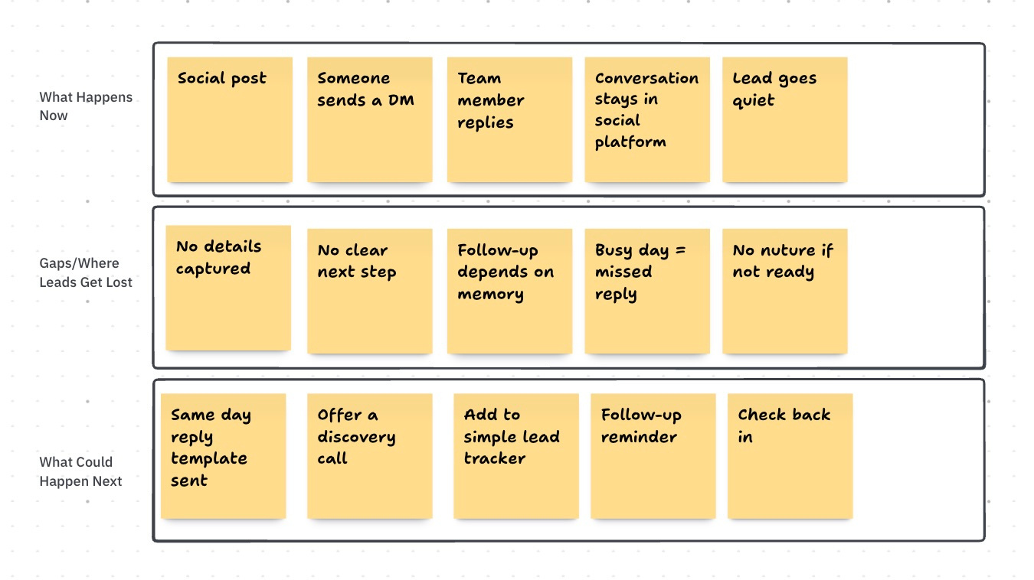
Mapping the Journey

Slide 12
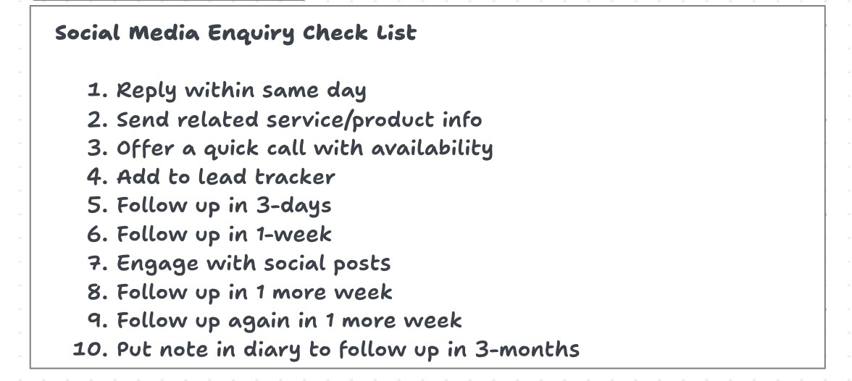
A simple documented process
can have a big impact ...

Slide 13
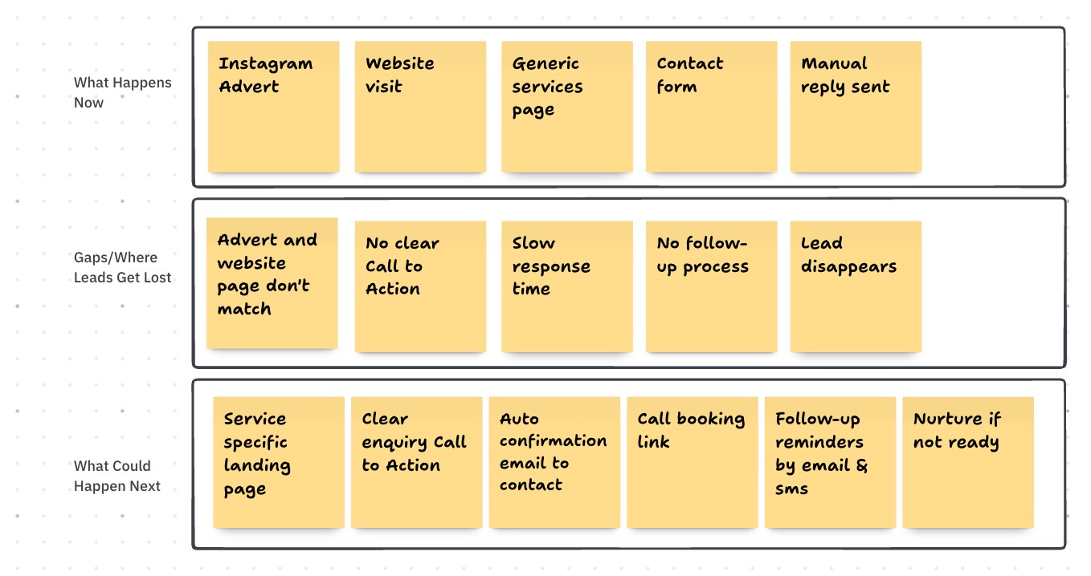
What Intentional Growth Can Look Like

Slide 14
Every touchpoint tells a story.
Are they all telling the same one?
Social
Event
Quote
Onboard
Follow-up

Slide 15
Consistency
compounds.

Slide 16
One simple thing to try this week
1
Pick one way leads enter your business.
“This is the beginning of your system”
2
Write down exactly what happens next.
3
Write down the gaps.
4
Write down what could happen next to remove those gaps

Slide 17
Growth should be intentional.
Not accidental.

Slide 18
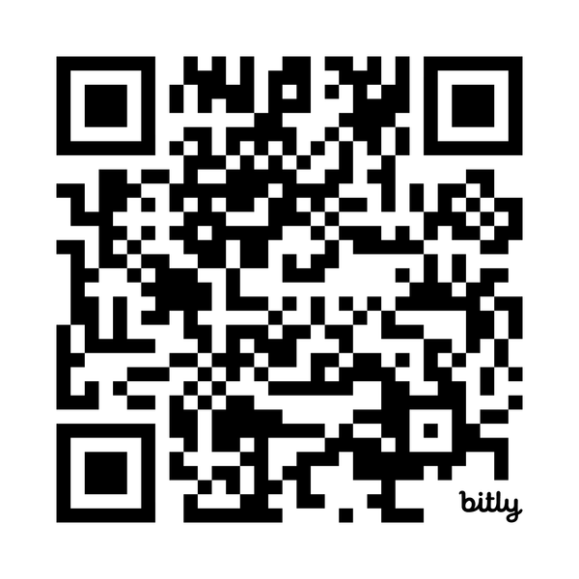
Allison Dore
Hello Friday Consulting
[ QR CODE ]
EMAIL
Allison@hellofriday.org
Scan for the
“What Happens Next?” Playbook

